Slide 1
Hands-on 2: Computer vision classification for cattle food grading with a hands-on exercise (Python) on Google Co-lab
Yalong Pi, Associate Research Scientist, Texas A&M Institute of Data Science
2025 ASAS, Sunday, July 6, 2025, 12:30 PM – 2:20 PM

Slide 2
Agenda
Fundamentals of machine learning (1 hour)
Feed grading with computer vision (30 minutes)

Slide 3
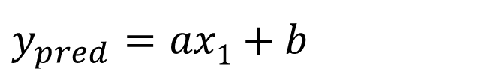
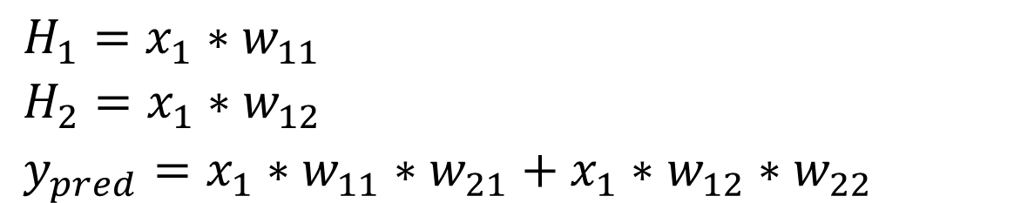
y
$y_{pred}$ $=ax1+b$
H₁
30
w₁₁
w₂₁
x₁
y
20
w₂₂
w₁₂
H₂
10
0
1
2
5
x
$H_{1}=x_{1}∗w_{11}$
$H_{2}=x_{1}∗w_{12}$
$y_{pred}=x_{1}∗w_{11}∗w_{21}+x_{1}∗w_{12}∗w_{22}$
x | y
1 | 10
2 | 20
5 | 30

Slide 4
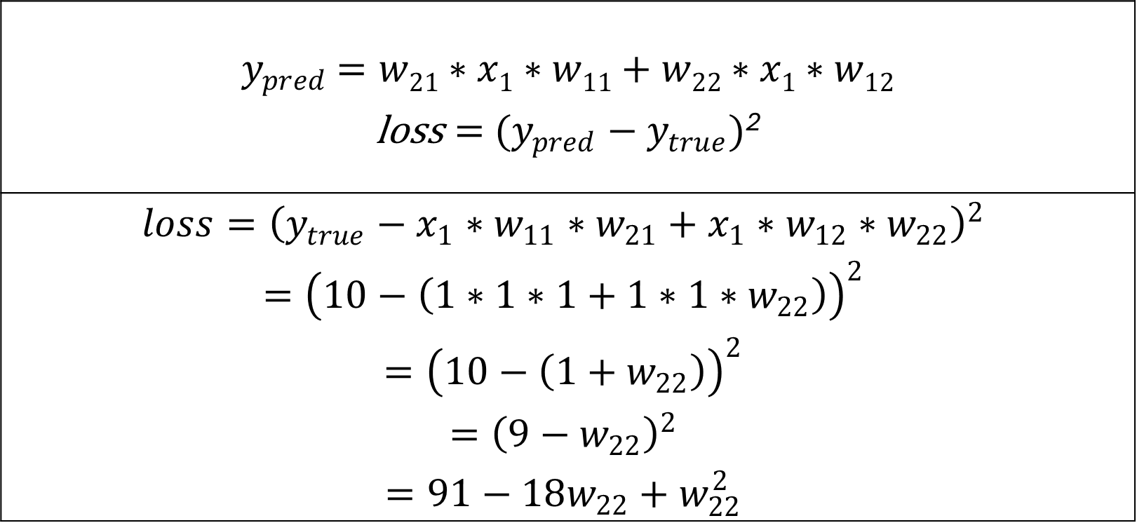
$y_{pred}$ $=w21∗x1∗w11+w22∗x1∗w12$ $\text{loss}={ (y_{pred}−y}_{true})$²
$$loss={\left(y_{true}−x_{1}∗w_{11}∗w_{21}+x_{1}∗w_{12}∗w_{22}\right)}^{2}$$ $$={\left(10−\left(1∗1∗1+1∗1∗w_{22}\right)\right)}^{2}$$ $$={\left(10−\left({1+w}_{22}\right)\right)}^{2}$$ $$={\left(9−w_{22}\right)}^{2}$$ $$=91−18w_{22}+w_{22}^{2}$$
x | y
1 | 10
2 | 20
5 | 30

Slide 5
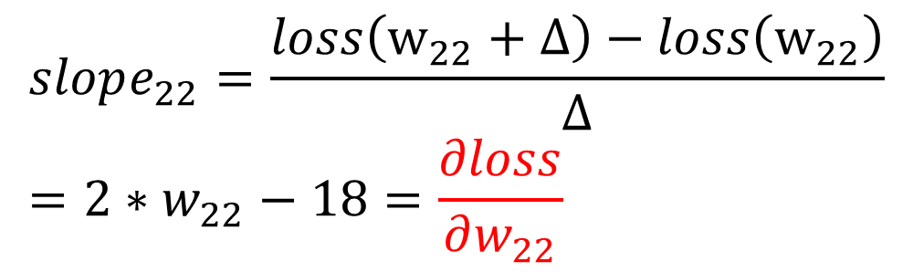
H₁
Loss
w₁₁
w₂₁
x₁
y
w₂₂
w₁₂
H₂
Slope: -
Slope: +
0
9
w₂₂
$$loss=91−18w_{22}+w_{22}^{2}$$
x | y
1 | 10
2 | 20
5 | 30
$$slope_{22}=\frac{loss\left(w_{22}+Δ\right)−loss\left(w_{22}\right)}{Δ}=2∗w_{22}−18=\frac{∂loss}{∂w_{22}}$$

Slide 6
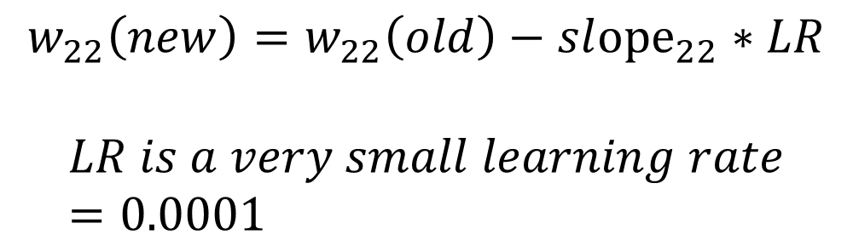
H₁
Loss
w₁₁
w₂₁
x₁
y
w₂₂
w₁₂
H₂
Slope: -
Slope: +
0
9
w₂₂
x | y
1 | 10
2 | 20
5 | 30
$$w_{22}\left(new\right)=w_{22}\left(old\right)−sl{ope}_{22}∗LR$$
$$LR is a very small learning rate=0.0001$$

Slide 7
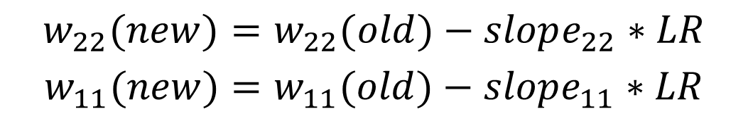
H₁
Loss
w₁₁
w₂₁
x₁
y
w₂₂
w₁₂
H₂
0
w₂₂
w₁₁
$$w_{22}(new)=w_{22}(old)−slope_{22}∗LR$$
$$w_{11}(new)=w_{11}(old)−slope_{11}∗LR$$
x | y
1 | 10
2 | 20
5 | 30

Slide 8

$$w_{22}(new)=w_{22}(old)−slope_{22}∗LR$$
$$w_{11}(new)=w_{11}(old)−slope_{11}∗LR$$
$$w_{12}(new)=w_{12}(old)−slope_{12}∗LR$$
$$w_{21}(new)=w_{21}(old)−slope_{21}∗LR$$
Loss
H₁
w₁₁
w₂₁
x₁
y
w₂₂
w₁₂
H₂
0
w₂₂
w₁₁

Slide 9
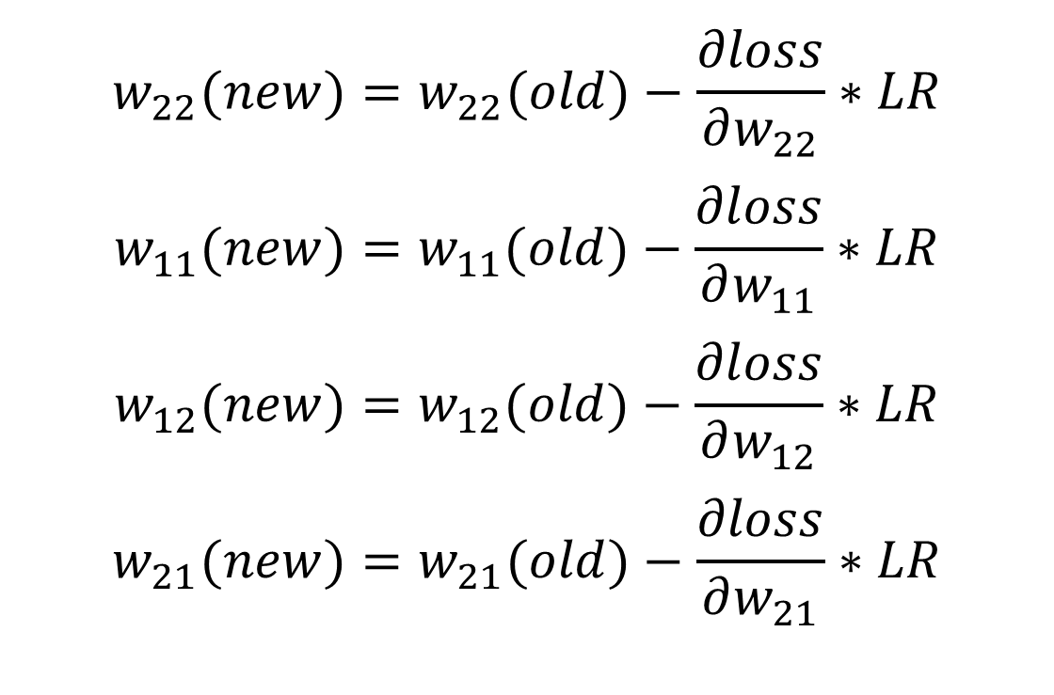
H₁
w₁₁
w₂₁
x₁
y
w₂₂
w₁₂
H₂
$$w_{22}(new)=w_{22}(old)−\frac{∂loss}{∂w_{22}}∗LR$$
$$w_{11}(new)=w_{11}(old)−\frac{∂loss}{∂w_{11}}∗LR$$
$$w_{12}(new)=w_{12}(old)−\frac{∂loss}{∂w_{12}}∗LR$$
$$w_{21}(new)=w_{21}(old)−\frac{∂loss}{∂w_{21}}∗LR$$

Slide 10
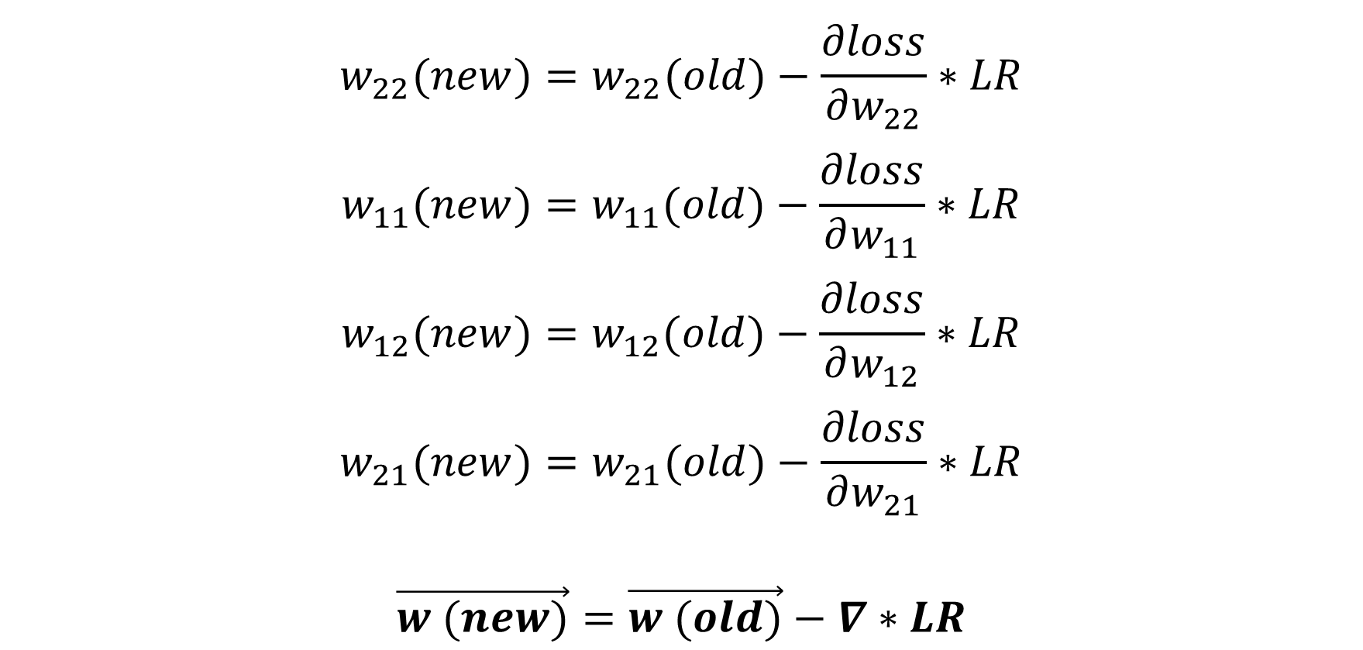
$$w_{22}(new)=w_{22}(old)−\frac{∂loss}{∂w_{22}}∗LR$$
$$w_{11}(new)=w_{11}(old)−\frac{∂loss}{∂w_{11}}∗LR$$
$$w_{12}(new)=w_{12}(old)−\frac{∂loss}{∂w_{12}}∗LR$$
$$w_{21}(new)=w_{21}(old)−\frac{∂loss}{∂w_{21}}∗LR$$
$$\vec{w (new)}=\vec{w (old)}−∇∗LR$$

Slide 11
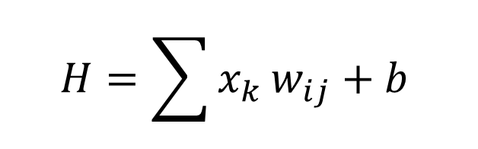
H₁
H
W₂₁
W₁₁
For each neuron H:
x₁
H₂
W₂₂
W₁₂
$$H=\sum{x_{k}}w_{ij}+b$$
y₁
x₂
y₂
w_{ij} is the weight
b is the bias
A DNN has millions of weights and biases
W_{ij}
H_{k}

Slide 12
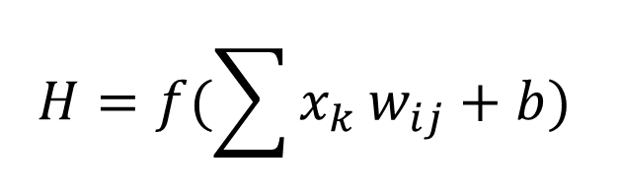
H₁
H
W₂₁
W₁₁
For each neuron H:
x₁
H₂
W₂₂
W₁₂
$$H=f(\sum{x_{k}}w_{ij}+b)$$
y₁
x₂
y₂
f is the activation function
w_{ij} is the weight
b is the bias
A DNN has millions of weights and biases
W_{ij}
H_{k}

Slide 13
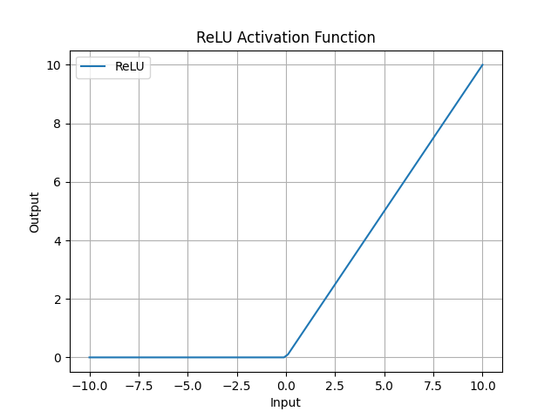

Slide 14
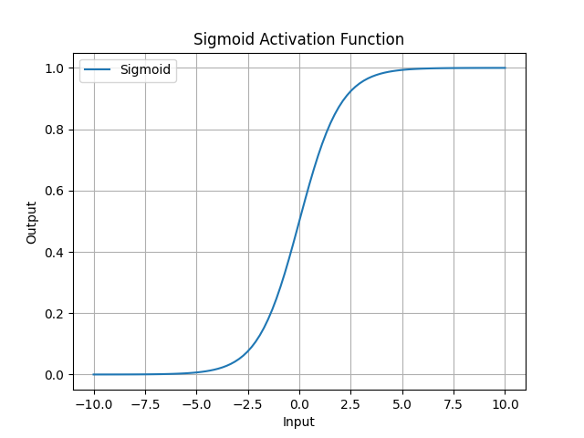

Slide 15
Output types
Regression
Classification
Feature extraction
Combination

Slide 16
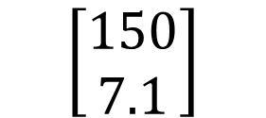
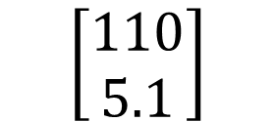


H₁
H
W₂₁
W₁₁
x₁
H₂
W₂₂
W₁₂
y₁
Weight (lbs)
$y_{pred}$
$y_{true}$
x₂
$$\left[\begin{aligned}110 \\ 5.1\end{aligned}\right]$$
$$\left[\begin{aligned}150 \\ 7.1\end{aligned}\right]$$
y₂
Height (feet)
W_{ij}
H_{k}

Slide 17
Regression loss
Mean absolute error
Mean square error
$$MAE=\frac{1}{n}|y_{pred}−y_{true}|$$
$$MSE=\frac{1}{n}{\left(y_{pred}−y_{true}\right)}^{2}$$

Slide 18
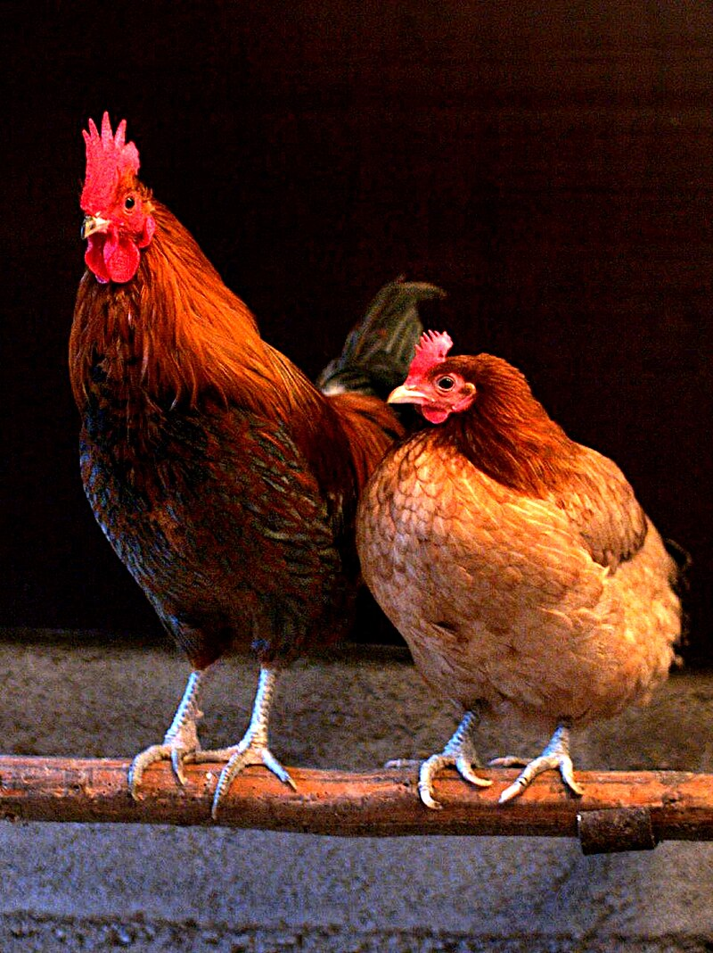
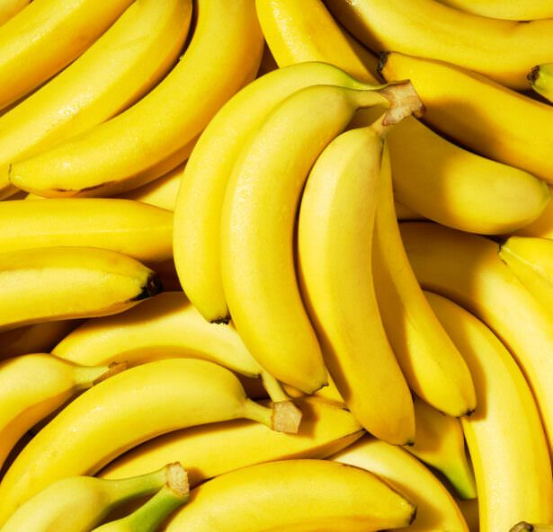
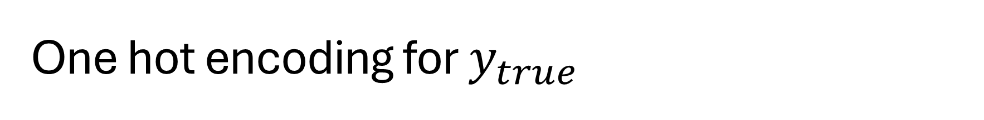


One hot encoding for $y_{true}$
$$\left[\begin{aligned}1 \\ 0\end{aligned}\right]$$
Chicken
Banana
$$\left[\begin{aligned}0 \\ 1\end{aligned}\right]$$

Slide 19
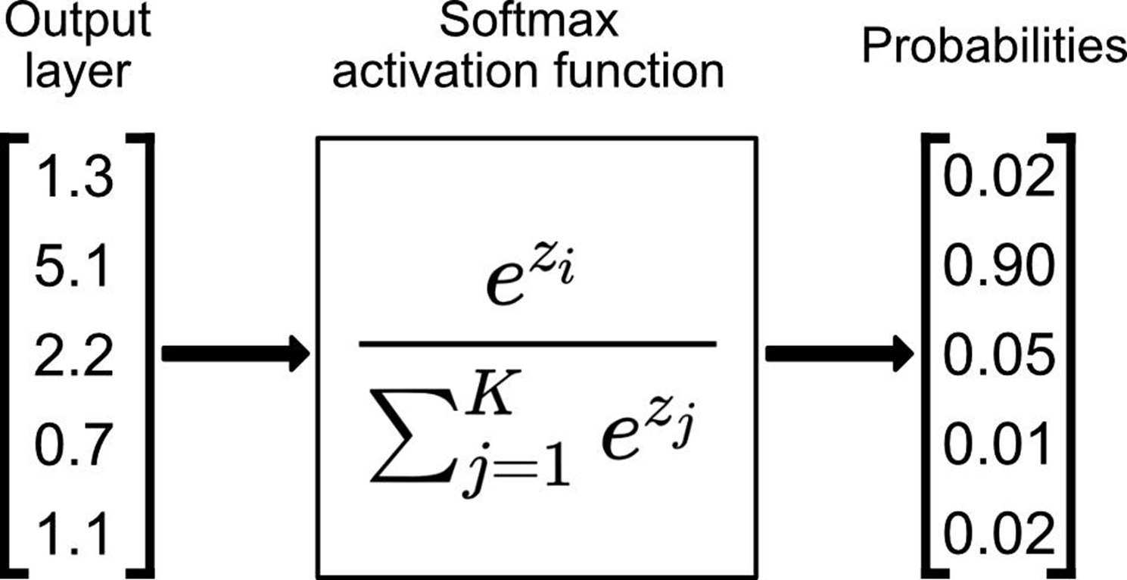
Softmax for y_pred

Slide 20

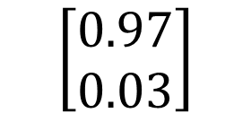


H₁
H
W₂₁
W₁₁
x₁
H₂
W₂₂
W₁₂
y₁
$y_{pred}$
$y_{true}$
Chicken
x₂
$$\left[\begin{aligned}0.97 \\ 0.03\end{aligned}\right]$$
$$\left[\begin{aligned}1 \\ 0\end{aligned}\right]$$
y₂
Banana
W_{ij}
H_{k}

Slide 21
Cross entropy loss for classification
Binary cross entropy
After softmax
Multi class entropy
After softmax
$$BCE=−\sum{y_{true}∗\log\left(y_{pred}\right)+\left(1−y_{true}\right)∗log⁡(1−y_{pred})}$$
$$CE=−\sum{y_{true}∗\log\left(y_{pred}\right)}$$

Slide 22
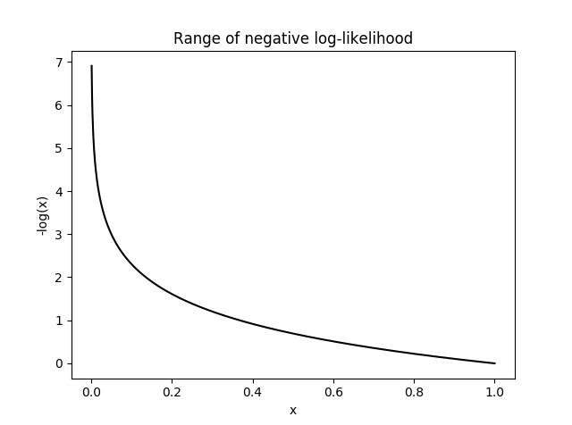

Slide 23
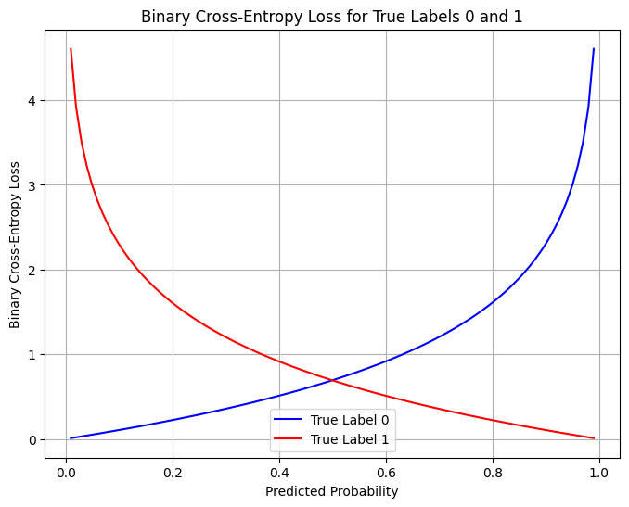

Slide 24


Weight update
H₁
H
W₂₁
W₁₁
x₁
H₂
W₂₂
W₁₂
Learn
Fit
Train
Back propagation
y_{1_true}
y₁
x₂
$$loss$$
y₂
y_{2_true}
W_{ij}
H_{k}
$$new \vec{w}=old \vec{w}−∇∗LR$$

Slide 25

Use the model
H₁
H
W₂₁
W₁₁
x₁
H₂
W₂₂
W₁₂
Forward pass
Inference
Test
Validation
Deployment
y₁
x₂
y₂
W_{ij}
H_{k}
$$NN\left(\vec{x}\right)=\vec{y}$$

Slide 26
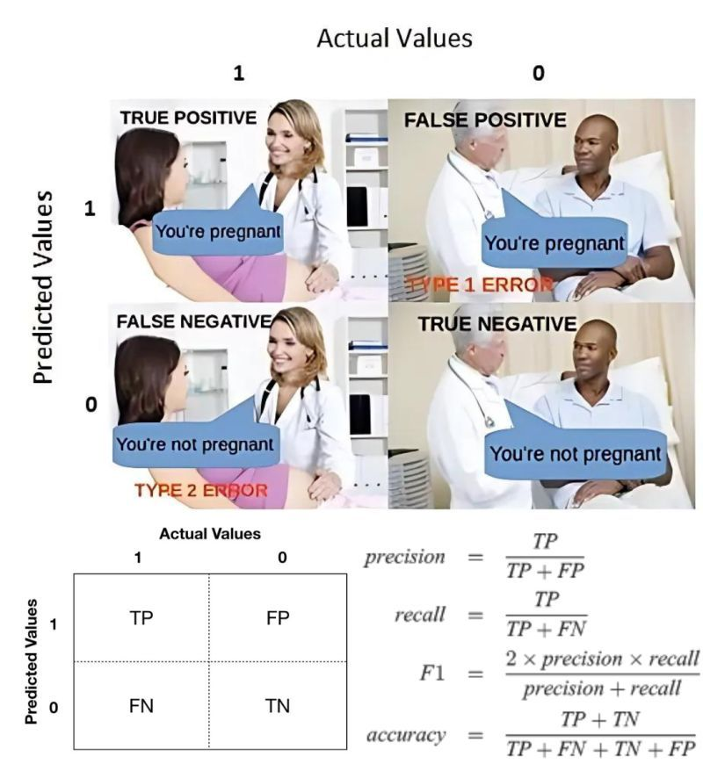
Image Credit: Linkedin.com

Slide 27
Underfitting
Overfitting
Loss
Validation
Training
0
Epoch

Slide 28
Computer vision

Slide 29
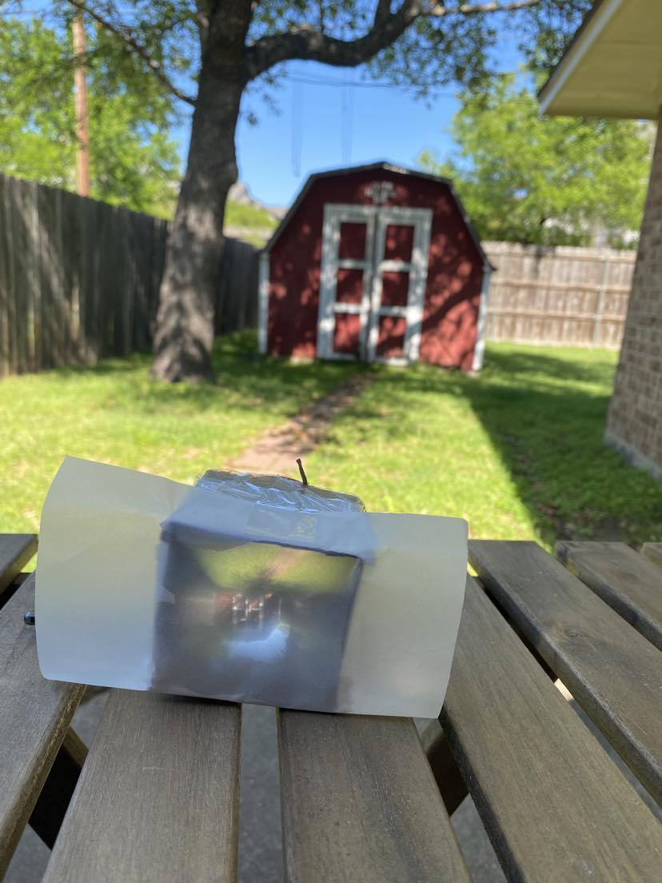
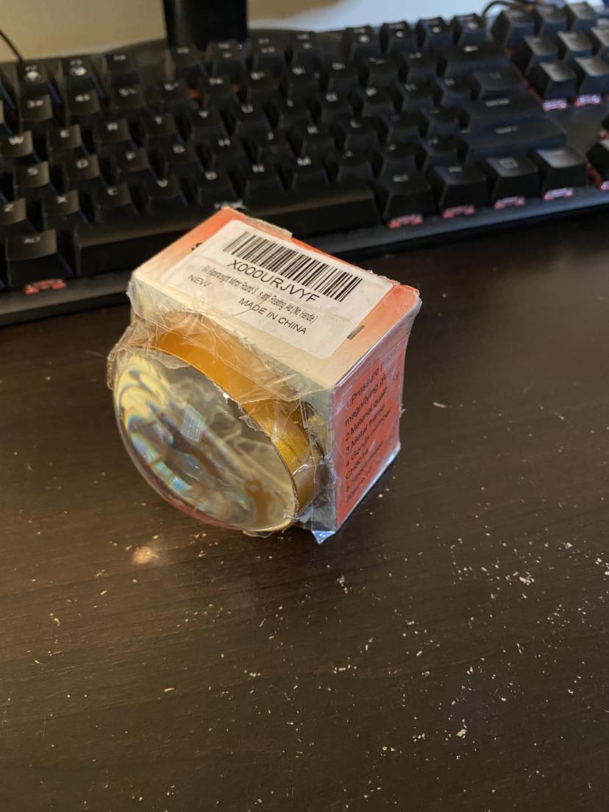

Slide 30
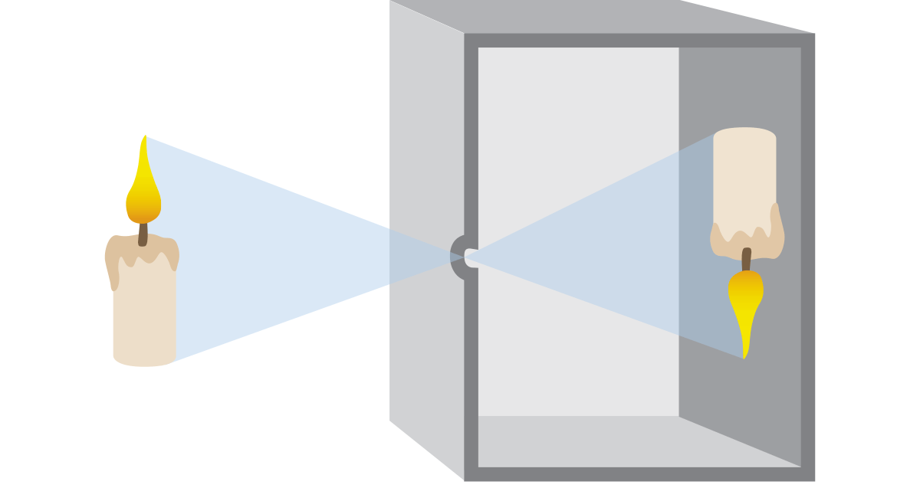
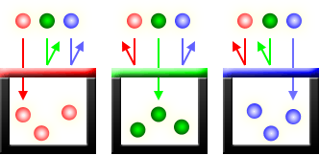
Pinhole principle
Traditional film
Digital sensors (CCD and CMOS)
Red Green Blue (RGB) channels

Slide 31
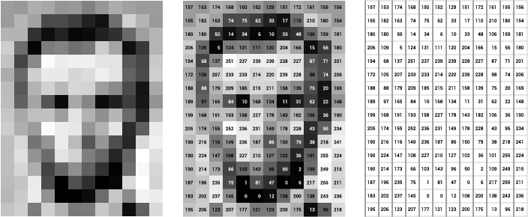
Grey Scale
Image of Abraham Lincoln as a matrix of pixel values. Image Credit: Thomas Smits

Slide 32

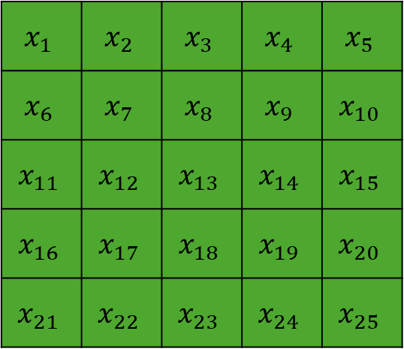
H₁
H
W₂₁
W₁₁
$$x_{1}$$ | $$x_{2}$$ | $$x_{3}$$ | $$x_{4}$$ | $$x_{5}$$
$$x_{6}$$ | $$x_{7}$$ | $$x_{8}$$ | $$x_{9}$$ | $$x_{10}$$
$$x_{11}$$ | $$x_{12}$$ | $$x_{13}$$ | $$x_{14}$$ | $$x_{15}$$
$$x_{16}$$ | $$x_{17}$$ | $$x_{18}$$ | $$x_{19}$$ | $$x_{20}$$
$$x_{21}$$ | $$x_{22}$$ | $$x_{23}$$ | $$x_{24}$$ | $$x_{25}$$
x₁
H₂
W₂₂
W₁₂
y₁
x₂
$$…$$
y₂
W_{ij}
H_{k}

Slide 33
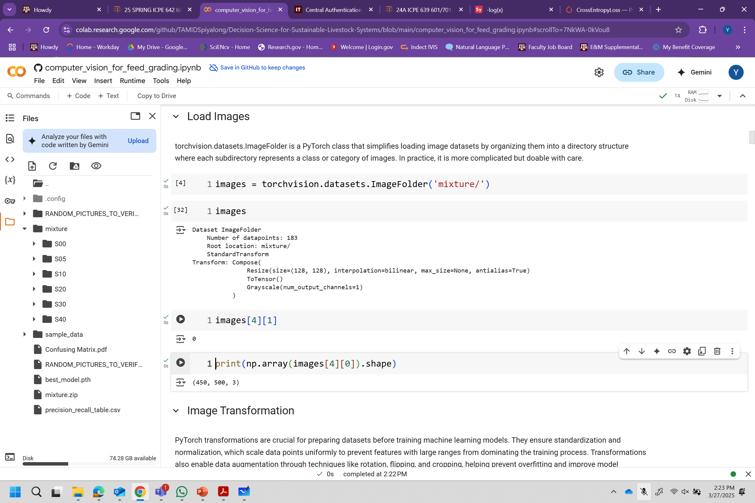

Slide 34
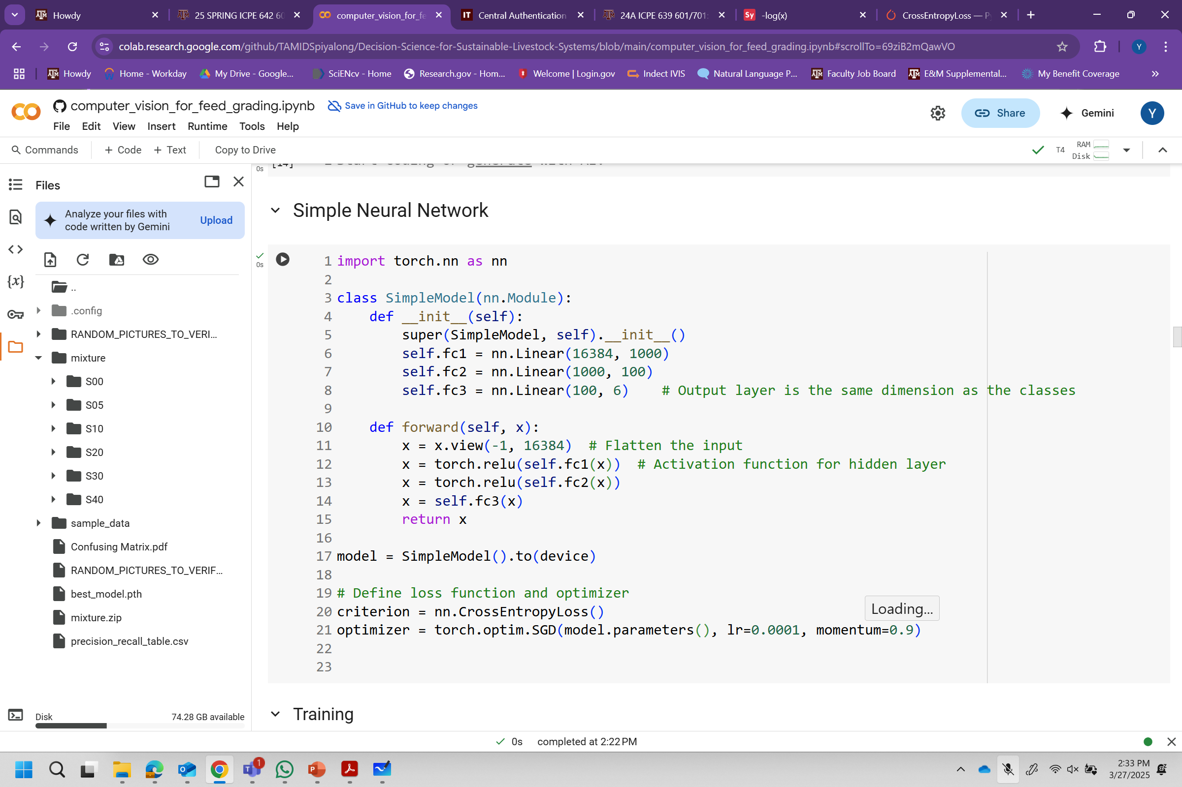

Slide 35
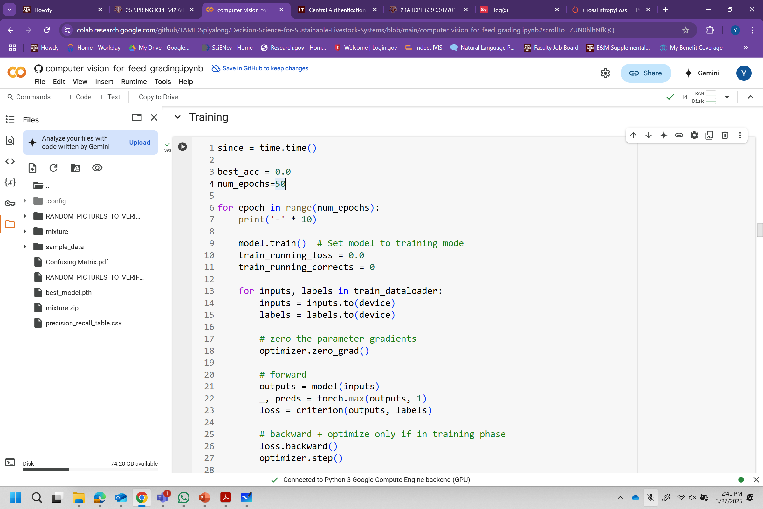

Slide 36
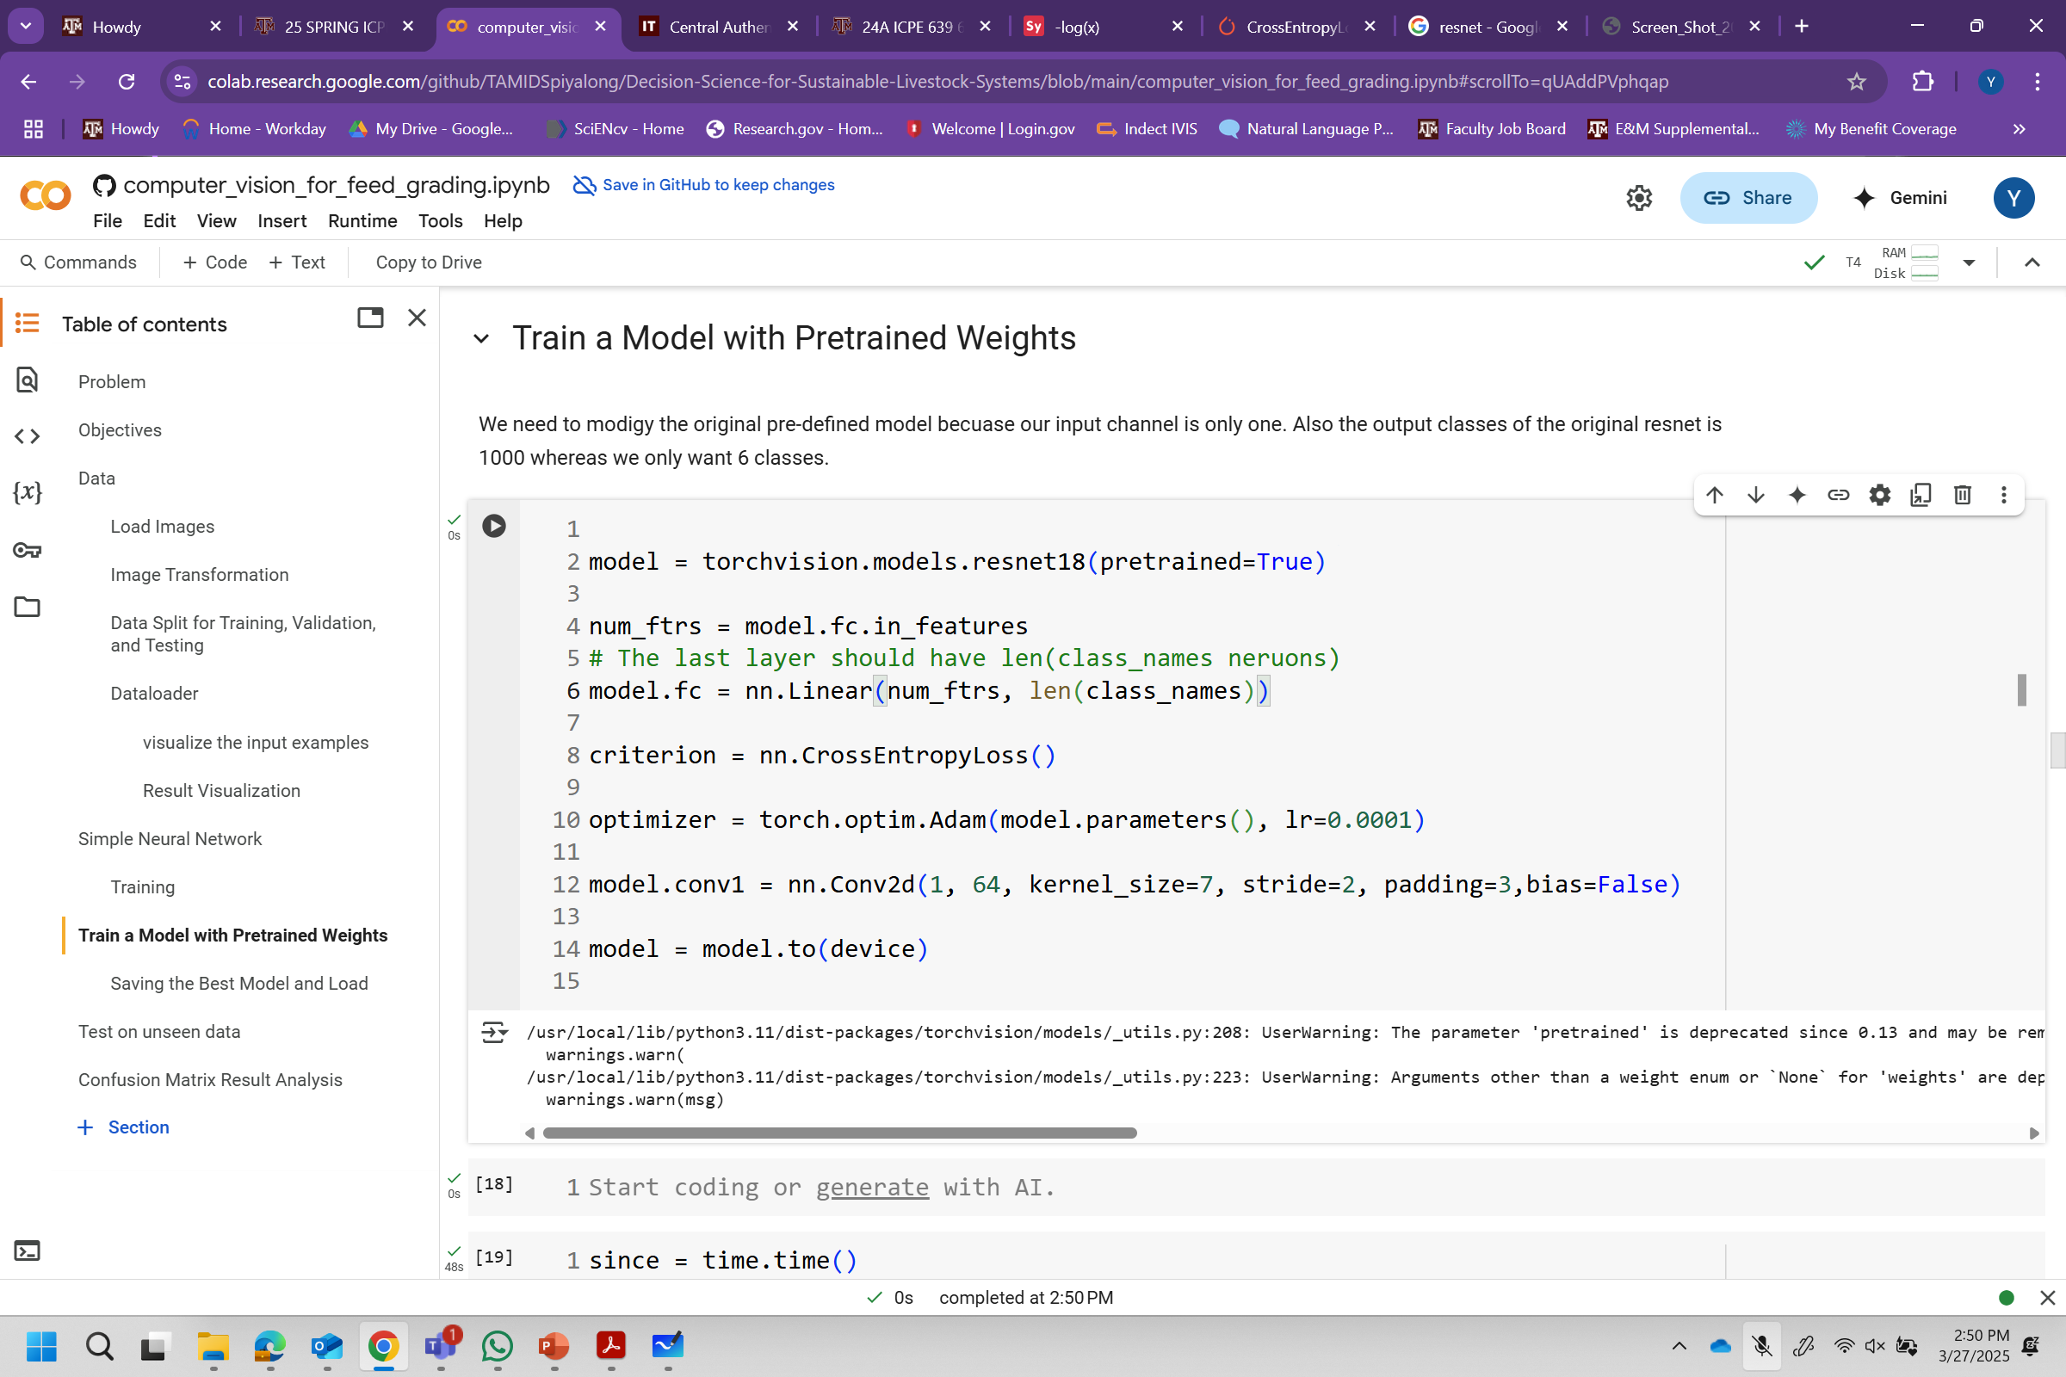

Slide 37
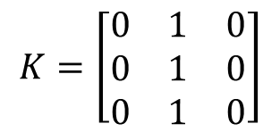
Convolution Computation
7 | 7 | 7 | 7 | 5
7 | 7 | 7 | 5 | 5
7 | 7 | 5 | 5 | 5
7 | 5 | 5 | 5 | 5
5 | 5 | 5 | 5 | 5
7 | 7 | 7 | 7 | 5
7 | 7 | 7 | 5 | 5
7 | 7 | 5 | 5 | 5
7 | 5 | 5 | 5 | 5
5 | 5 | 5 | 5 | 5
7 | 7 | 7 | 7 | 5
7 | 7 | 7 | 5 | 5
7 | 7 | 5 | 5 | 5
7 | 5 | 5 | 5 | 5
5 | 5 | 5 | 5 | 5
$$K=\left[\begin{matrix}0 & 1 & 0 \\ 0 & 1 & 0 \\ 0 & 1 & 0\end{matrix}\right]$$
0 | 0 | 0 | 0 | 0
0 | 21 | 19 | 17 | 0
0 | 19 | 17 | 15 | 0
0 | 17 | 15 | 15 | 0
0 | 0 | 0 | 0 | 0
Kernel at position 1
Kernel at position 2
Kernel at position n

Slide 38
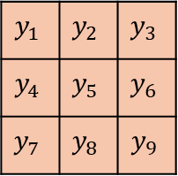
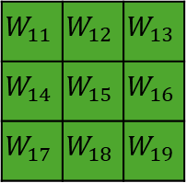
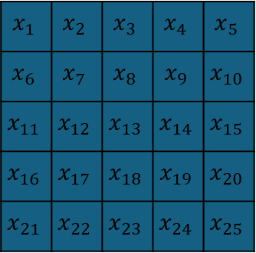
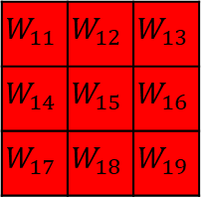
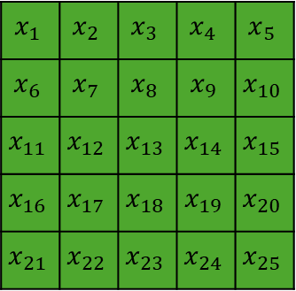

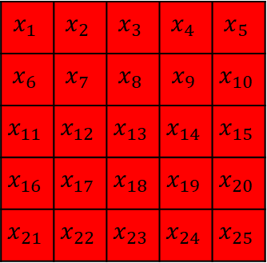

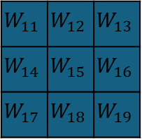

$$x_{1}$$ | $$x_{2}$$ | $$x_{3}$$ | $$x_{4}$$ | $$x_{5}$$
$$x_{6}$$ | $$x_{7}$$ | $$x_{8}$$ | $$x_{9}$$ | $$x_{10}$$
$$x_{11}$$ | $$x_{12}$$ | $$x_{13}$$ | $$x_{14}$$ | $$x_{15}$$
$$x_{16}$$ | $$x_{17}$$ | $$x_{18}$$ | $$x_{19}$$ | $$x_{20}$$
$$x_{21}$$ | $$x_{22}$$ | $$x_{23}$$ | $$x_{24}$$ | $$x_{25}$$
$$x_{1}$$ | $$x_{2}$$ | $$x_{3}$$ | $$x_{4}$$ | $$x_{5}$$
$$x_{6}$$ | $$x_{7}$$ | $$x_{8}$$ | $$x_{9}$$ | $$x_{10}$$
$$x_{11}$$ | $$x_{12}$$ | $$x_{13}$$ | $$x_{14}$$ | $$x_{15}$$
$$x_{16}$$ | $$x_{17}$$ | $$x_{18}$$ | $$x_{19}$$ | $$x_{20}$$
$$x_{21}$$ | $$x_{22}$$ | $$x_{23}$$ | $$x_{24}$$ | $$x_{25}$$
$$x_{1}$$ | $$x_{2}$$ | $$x_{3}$$ | $$x_{4}$$ | $$x_{5}$$
$$x_{6}$$ | $$x_{7}$$ | $$x_{8}$$ | $$x_{9}$$ | $$x_{10}$$
$$x_{11}$$ | $$x_{12}$$ | $$x_{13}$$ | $$x_{14}$$ | $$x_{15}$$
$$x_{16}$$ | $$x_{17}$$ | $$x_{18}$$ | $$x_{19}$$ | $$x_{20}$$
$$x_{21}$$ | $$x_{22}$$ | $$x_{23}$$ | $$x_{24}$$ | $$x_{25}$$
$$y_{1}$$ | $$y_{2}$$ | $$y_{3}$$
$$y_{4}$$ | $$y_{5}$$ | $$y_{6}$$
$$y_{7}$$ | $$y_{8}$$ | $$y_{9}$$
Input matrix: 5x5x3
(red)$y_{1}$
$$W_{11}$$ | $$W_{12}$$ | $$W_{13}$$
$$W_{14}$$ | $$W_{15}$$ | $$W_{16}$$
$$W_{17}$$ | $$W_{18}$$ | $$W_{19}$$
$$W_{11}$$ | $$W_{12}$$ | $$W_{13}$$
$$W_{14}$$ | $$W_{15}$$ | $$W_{16}$$
$$W_{17}$$ | $$W_{18}$$ | $$W_{19}$$
$$W_{11}$$ | $$W_{12}$$ | $$W_{13}$$
$$W_{14}$$ | $$W_{15}$$ | $$W_{16}$$
$$W_{17}$$ | $$W_{18}$$ | $$W_{19}$$
(green)$y_{1}$
Output size: 3x3x2
(blue)$y_{1}$
Kernel size: 3x3x3

Slide 39
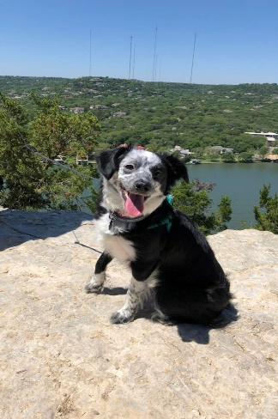
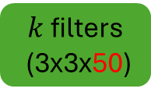

Convolutional Nueral Network
$$y_{1},y_{2},…y_{n}$$
…
…
RGB Input
(128x128x3)
50 filters
(3x3x3)
Tensor
(128x128x50)
$k$ filters
(3x3x50)
Output
(1000 classes)
…

Slide 40
https://github.com/TAMIDSpiyalong/2025ASAS.git
Objective
Data
Simple neural network
Convolutional network (pre-trained)
Test on unseen data
Result visualization

Slide 41
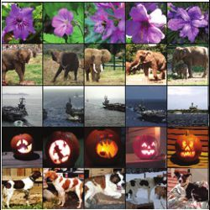
Large dataset
COCO: https://cocodataset.org/#home (80 classes)
ImageNet (1000 classes with 1.3M labeled images)
Common Crawl (~100TB+)

Slide 42


Transfer learning
$$y_{1},y_{2},…y_{80}$$
…
…
…
Input
Convolution layer
Output (80)

Slide 43

Transfer learning
$$y_{1},y_{2},…y_{6}$$
…
…
…
Input
Convolution layer
Output (6)

Slide 44
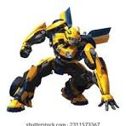
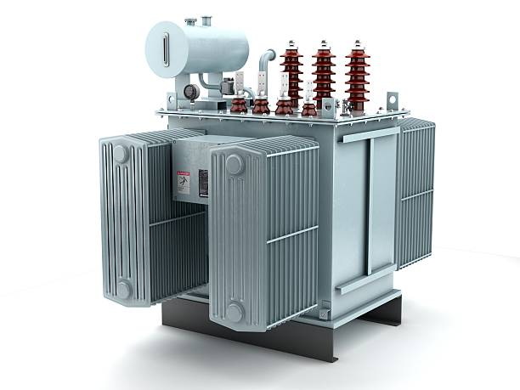
Transformer
GPT: Generative Pre-trained Transformer
Tokenization: https://tiktokenizer.vercel.app/
Vectorization: https://projector.tensorflow.org/

Slide 45
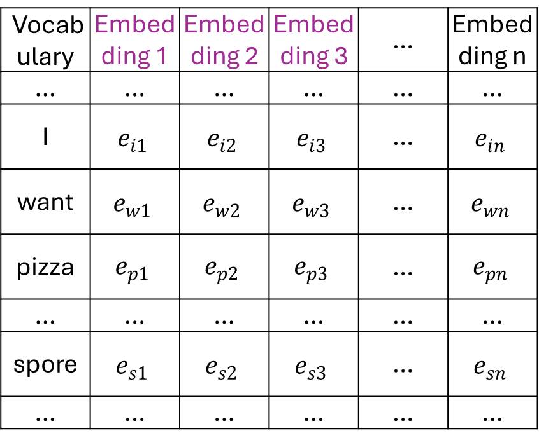
… | I | want | pizza | … | spore | …
Total Text Corpus
Vocabulary | Embedding 1 | Embedding 2 | Embedding 3 | … | Embedding n
… | … | … | … | … | …
I | $$e_{i1}$$ | $$e_{i2}$$ | $$e_{i3}$$ | … | $$e_{in}$$
want | $$e_{w1}$$ | $$e_{w2}$$ | $$e_{w3}$$ | … | $$e_{wn}$$
pizza | $$e_{p1}$$ | $$e_{p2}$$ | $$e_{p3}$$ | … | $$e_{pn}$$
… | … | … | … | … | …
spore | $$e_{s1}$$ | $$e_{s2}$$ | $$e_{s3}$$ | … | $$e_{sn}$$
… | … | … | … | … | …
Embedding 1
I
pizza
want
spore
Embedding 2
Embedding 3

Slide 46
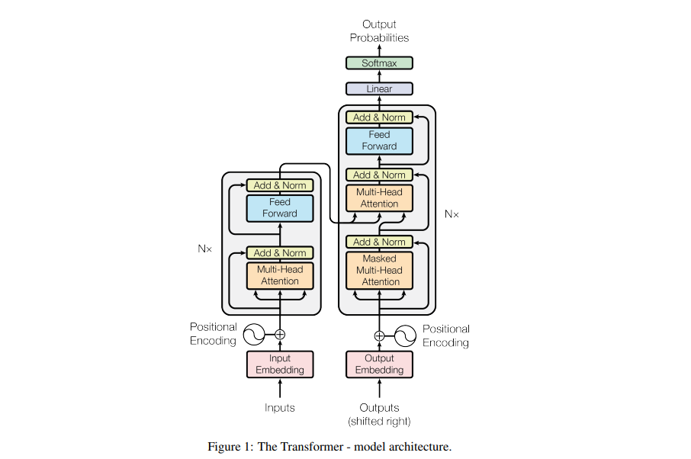
Vaswani, A. (2017). Attention is all you need. Advances in Neural Information Processing Systems.

Slide 47
GPT 3
Parameters 175 B
Dataset 45T
96 attention heads
2048 token size
Learn from their chief scientist: https://www.youtube.com/watch?v=kCc8FmEb1nY

